Slide 1
AI that sees and reads: images, documents and speech
What can AI see or read for us, and when should we not trust what it sees?
Leading with AI | Session 1 of the 15 (Sessions 0 to 14)
KLAi Professional Learning | Jotham Martin Wambi
Notes:
Welcome back. In Session 0 we drew the map: AI as a family, a model that learns from examples the way a new employee learns from past files, and the four jobs AI does. Today takes the first job, seeing and reading. Our question: what can AI see or read for us, and when should we not trust what it sees?
We start with a phone app built at Makerere, build the idea one picture at a time with no maths, tour six industries, and watch a small network learn to read handwriting. Then you add a use of your own to your AI Opportunity Portfolio.

Slide 2



Today in one view: what you will leave with
By the end of today you will have
Say in plain words how a model learns to see from labelled photos, and why reading documents and turning speech into text are the same idea
Spot when a seeing or reading system will struggle: a new picture unlike its examples, poor images, something it never saw
Add one place where AI could see or read for you to your AI Opportunity Portfolio
Notes:
That question breaks into three things you will be able to do by the end. You will say, in plain words, how a model learns to see from labelled photos, and why reading a document and turning speech into text are the same idea. You will spot when such a system will struggle, before a vendor tells you.
And your portfolio will hold one place in your organisation where AI could see or read for you.

Slide 3
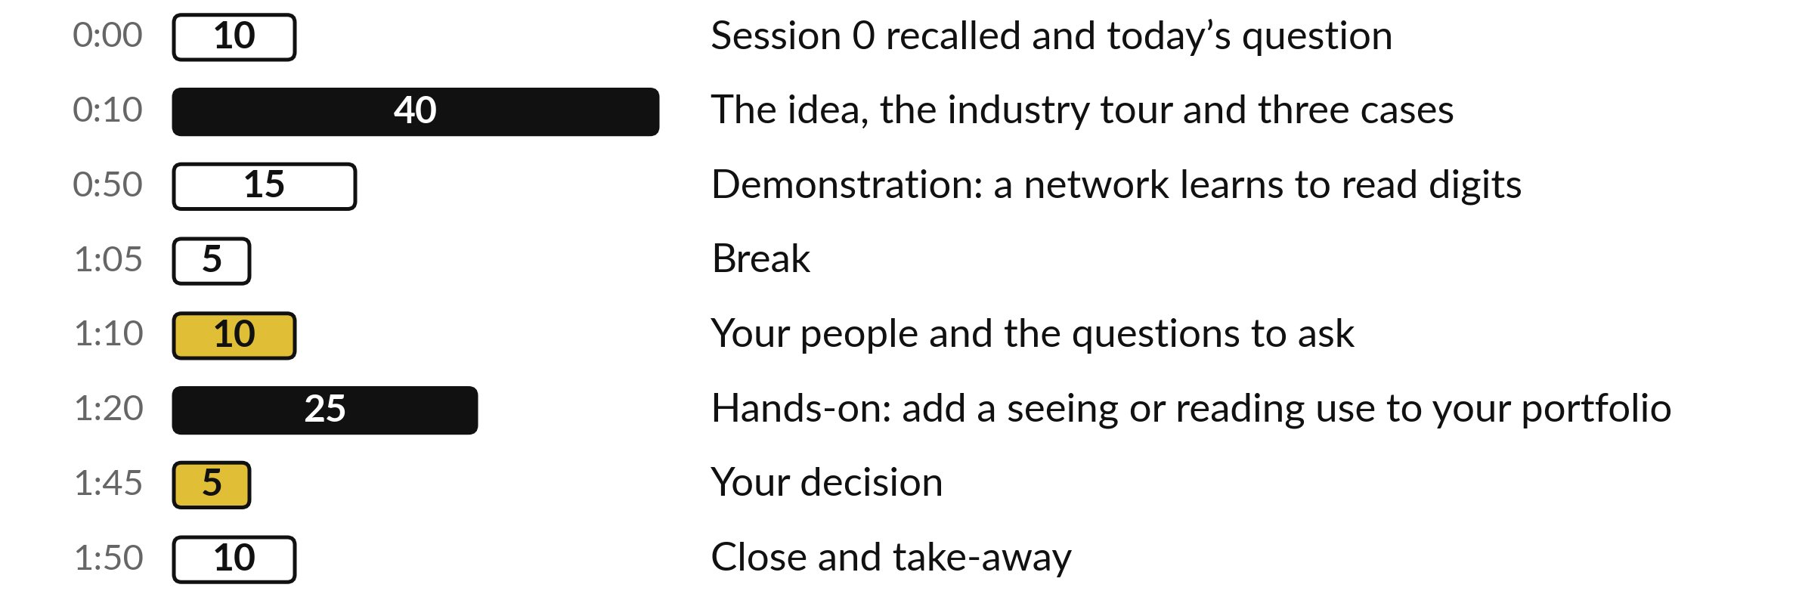
Your two hours: the idea, the industries,
a demonstration, then your own portfolio
I run a recorded demonstration and one live one. You add a use to your own portfolio.
Notes:
Here is how the two hours run. Ten minutes to connect with Session 0 and meet today’s question. Forty minutes on the idea, one picture at a time, then the tour of six industries and three real cases. Fifteen minutes of demonstration: a recorded network that learned to read handwriting, and a live try with a receipt.
A five-minute break. Ten minutes on your people and the questions to ask. Then twenty-five minutes on your own portfolio, five on your decision, and ten to close.

Slide 4

Two questions from last time
1. In Session 0, how does a model learn?
2. What are the four jobs AI does?
Answer aloud first. Then we check together.
Notes:
Two quick questions from Session 0. Answer aloud first, and then we check together. It is a warm-up to bring last time back.
Question one. In Session 0, how does a model learn? Take a moment.
A good answer is this. From past examples whose outcome is known, the way a new employee learns from past files.
Question two. What are the four jobs AI does? Say it to yourself first.
A good answer is this. See and read, predict, understand and write language, and act.
If an answer was missing, last session’s take-away sheet or workbook page has it. Now to today.

Slide 5
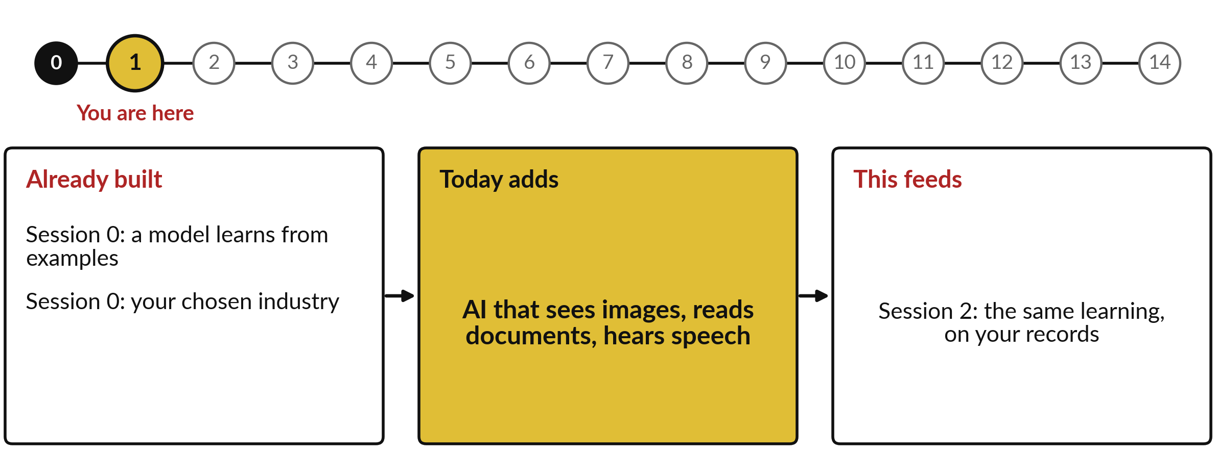
How today connects: what we
already have and what it feeds
Each session is built on the ones before it.
Notes:
So where does today sit in the story? The dots along the top are the fifteen sessions, from the map at Session 0 to your plan at Session 14, and the gold one is today.
We already hold a model learns from examples from Session 0 and your chosen industry from Session 0. Nothing today starts from zero.
What today adds is this: aI that sees images, reads documents, hears speech.
And it feeds straight into what comes next. Session 2: the same learning, on your records. Keep that chain in mind, because each idea you learn today is a step on it.

Slide 6


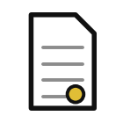

Words we use today
Word | What it means
Pixel | One dot of a picture. The computer reads each dot as a number.
Training data | The labelled examples a model learns from, such as photos marked healthy or diseased.
Neural network | A model built in layers that finds small details, then shapes, then the answer.
OCR | Optical character recognition: software that reads printed or handwritten letters from a scan or photo.
Speech recognition | Software that turns recorded speech into written text, also called speech-to-text.
Notes:
Five words for today. I give the plain meaning of each, and we use every one of them before the end of the session.
Pixel. One dot of a picture. The computer reads each dot as a number.
Training data. The labelled examples a model learns from, such as photos marked healthy or diseased.
Neural network. A model built in layers that finds small details, then shapes, then the answer.
OCR. Optical character recognition: software that reads printed or handwritten letters from a scan or photo.
Speech recognition. Software that turns recorded speech into written text, also called speech-to-text.
Keep those words close. The first idea uses them straight away, so let us begin.

Slide 7
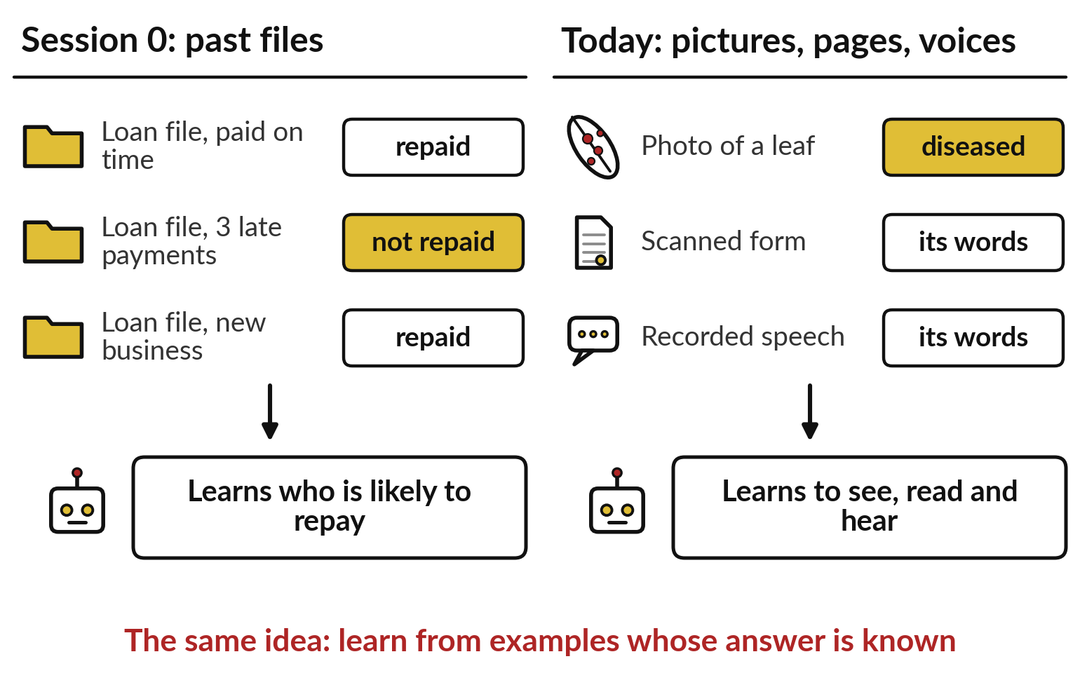
From Session 0 to today: the same learning,
now from pictures, pages and voices
A model that learns from past files can learn from labelled photos.
In Session 0 the examples were files.
Today they are photos, scanned pages and recordings.
Seeing and reading is the first of the four jobs.
Notes:
Those five words rest on one idea you already hold. In Session 0 a model learned the way a new employee learns from past files: each file carried its outcome, repaid or not, and the model found the pattern. On the left is that picture. On the right is today.
Swap the files for photos of leaves, scanned forms or recorded speech, and swap the outcome for what an expert says the photo shows, or what the page or the voice really says. The learning is the same. Seeing and reading is the first of the four jobs from Session 0.
So who near us already does it?

Slide 8
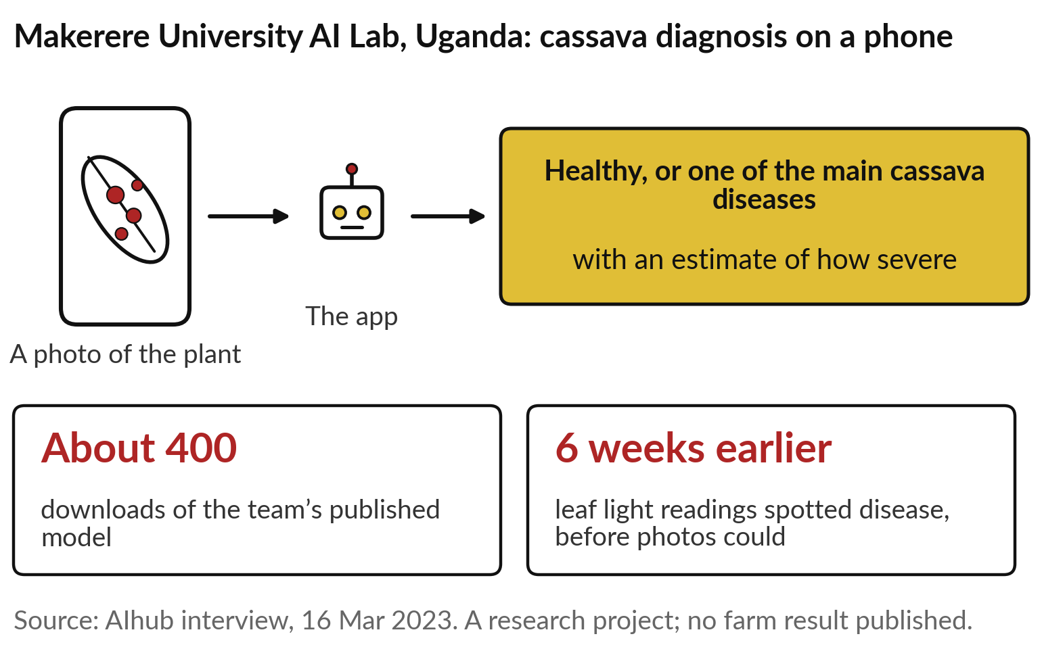
Makerere University: a phone photo
of a cassava plant names the disease
Today’s question: what can AI see or read for us?
Built in Kampala, for farmers and extension workers.
Learned from photos labelled by experts.
Ask: how does it know, and when is it wrong?
Notes:
The answer starts on a farm near us. A team at Makerere University’s AI lab, with the national crops research institute, built a phone app for cassava. A farmer or extension worker photographs the plant, and the app says healthy, or names one of the main cassava diseases, with an estimate of how severe.
Farmers’ photos also carried their location, so researchers could map where disease spread. The lead researcher reports about 400 downloads of the published model, and that light readings from the leaf spotted disease about six weeks before photos could. It was a research project, and no farm-level result was published.
So how can a phone tell a sick leaf from a healthy one?

Slide 9
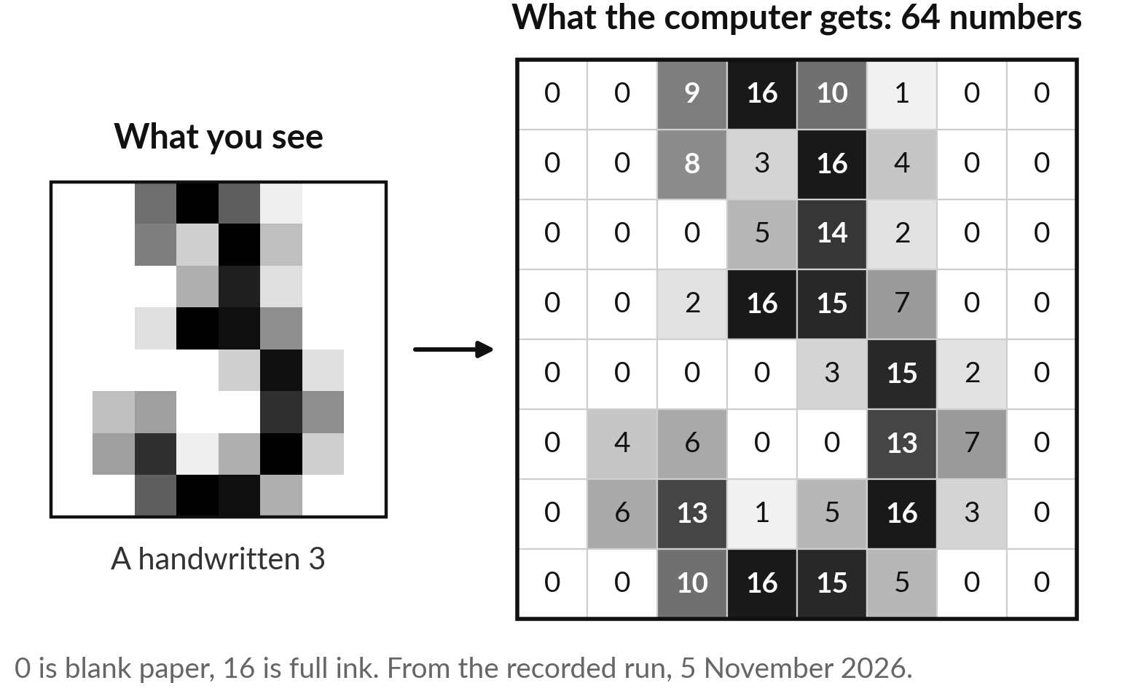
To a computer, a photo is a grid
of dots, and every dot is a number
The machine never sees a leaf or a letter. It sees numbers.
Each dot is a pixel: dark ink a high number, blank paper a low one.
This 3 is 64 numbers; a phone photo is millions.
Notes:
To answer that, we first need to know what the phone gets. It never sees a leaf the way you do. It gets a grid of dots, which the industry calls pixels, and each dot is a number. On the left is a handwritten 3 from today’s demonstration, as you see it.
On the right is what the computer gets: 64 numbers, 0 for blank paper and 16 for full ink. A colour photo works the same way, with three numbers per dot for red, green and blue, so a photo a thousand dots wide and a thousand high is three million numbers.
Seeing, for a machine, means finding patterns in those numbers. Where does it learn which patterns matter?

Slide 10
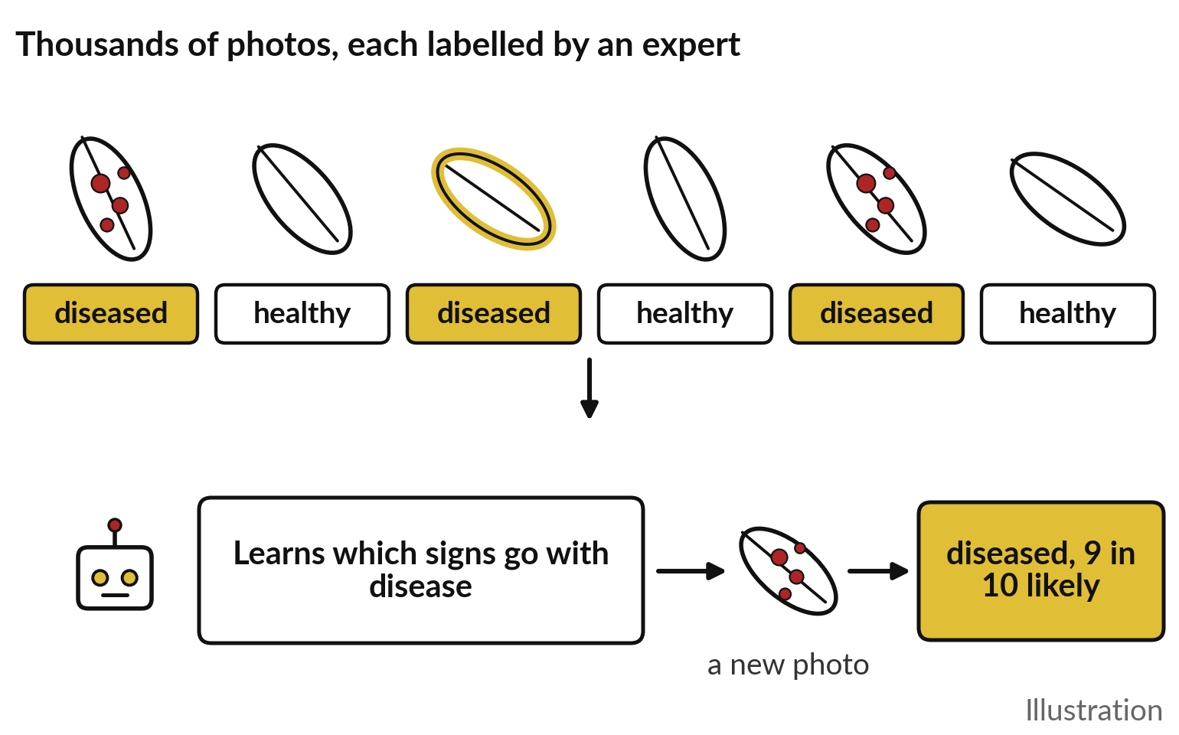
It learns from thousands of photos
that experts have already labelled
Like an apprentice shown thousands of examples by an expert.
Each photo carries its label: healthy or diseased.
Those labelled photos are the training data.
Then it judges a new photo it has never seen.
Notes:
It learns from examples, exactly as in Session 0. Think of an apprentice agronomist. A senior expert shows them thousands of leaves and says each time: healthy, diseased, diseased, healthy. After enough of them, the apprentice can judge a new leaf alone. A model learns the same way.
Experts label thousands of photos, healthy or diseased, and the industry calls that labelled set the training data. The model looks for the signs that go with each label, brown spots, yellow edges, and then judges a new photo it has never seen, giving a likelihood such as 9 in 10 diseased.
That figure is illustrative. The labels matter most: if the experts were wrong, the model learns their mistakes. But how does it find those signs?

Slide 11
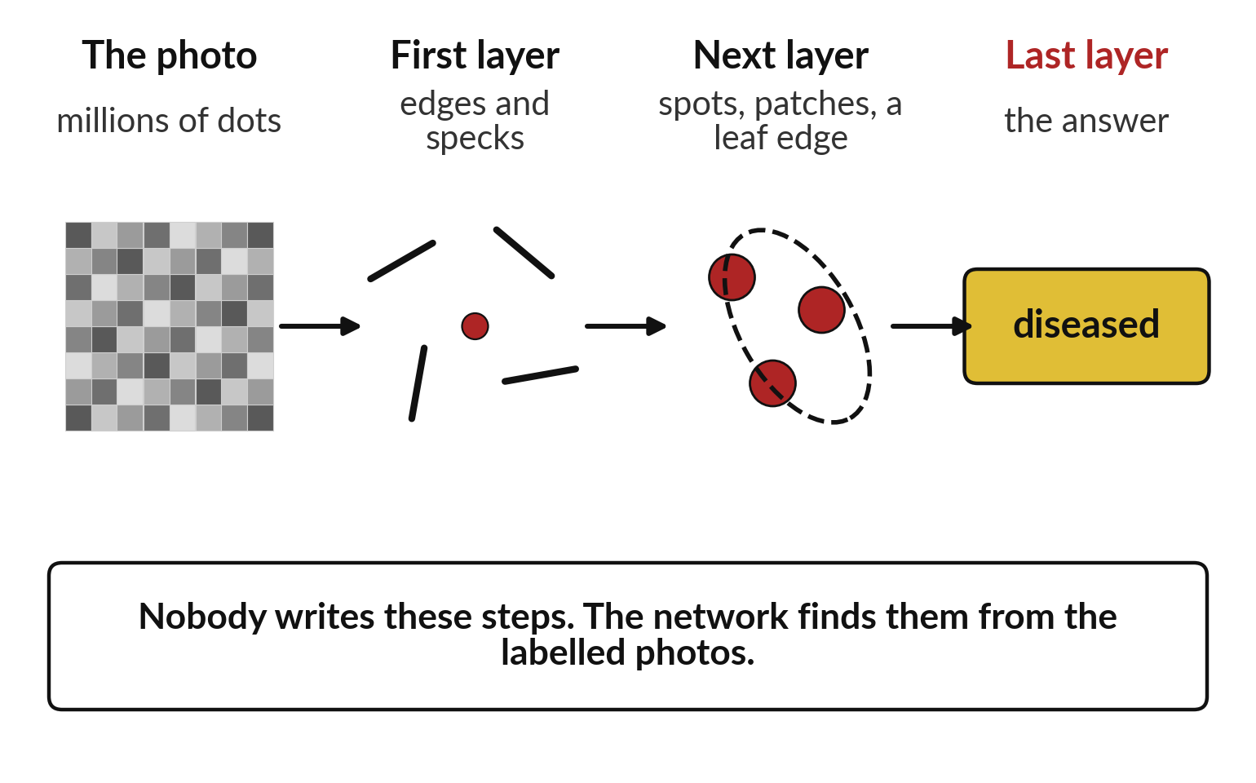
It looks in layers: small details
first, then shapes, then the answer
The industry calls this a neural network; many layers make it deep learning.
Early layers find edges and specks.
Later layers combine them into spots and shapes.
Nobody writes these steps; the photos teach them.
Notes:
It finds them in layers, a little like your own eye and brain. The first layer looks at small groups of dots and picks out edges and specks. The next layer combines those into larger things: a spot, a patch, the edge of a leaf. The last layer weighs what it found and gives the answer, diseased.
A model built like this is called a neural network, and one with many layers is what people mean by deep learning. The striking part is that nobody writes these steps. The network adjusts itself, photo after photo, until its answers match the labels. In today’s demonstration you will see one such network learn.
Now, what about pages instead of leaves?

Slide 12
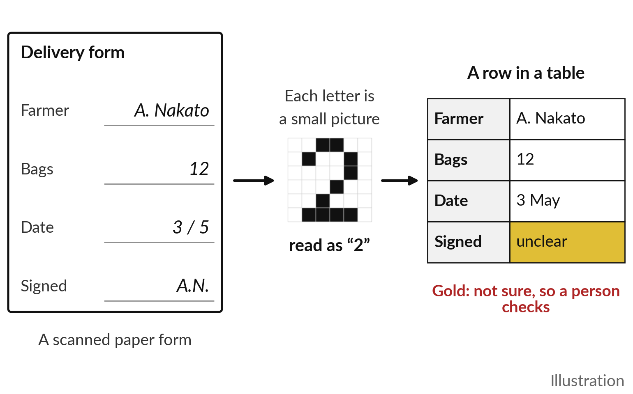
Reading a document is the same
idea: every letter is a small picture
The scan becomes text, and the text becomes a row in a table.
The industry calls it OCR, optical character recognition.
It learned from pages whose words were already typed out.
Fields it is unsure of go to a person.
Notes:
Pages work the same way, which is why they belong in today’s session. A scanned form or a phone photo of a receipt is also a grid of dots. Each letter or figure is a small picture, and a model that learned from thousands of pages whose words were already typed out can say: that shape is a 2.
The industry calls this OCR, optical character recognition. Modern tools go one step further and put each value in its place: farmer, bags, date. The good ones also say when they are unsure, as in the gold box, so a person checks that field. Handwriting, stamps and creases make it harder. And the same idea reaches one more input.

Slide 13
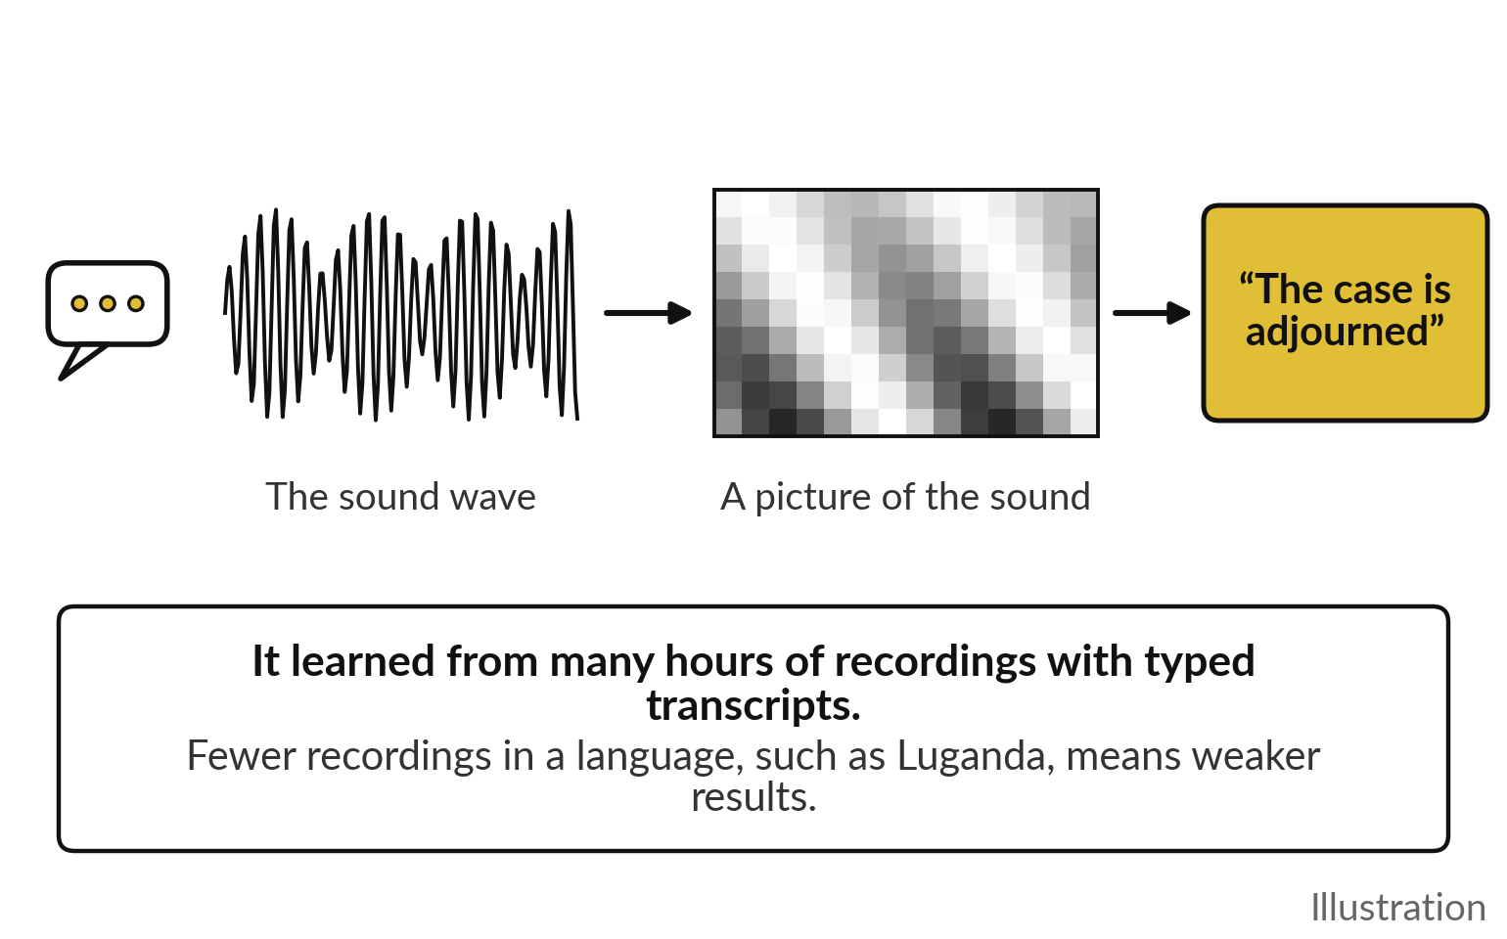
Turning speech into text is the same
idea again: the sound becomes a picture
The industry calls it speech recognition, or speech-to-text.
The recording is drawn as a picture of the sound.
It learned from hours of speech with typed transcripts.
Fewer recordings in a language mean weaker results.
Notes:
That input is the human voice. A recording is a wave of sound, and the system first turns it into a picture of the sound, light and dark bands showing which tones were loud at each moment. Then, just as with leaves and letters, a model that learned from many hours of recordings with typed transcripts says which words that picture holds.
The industry calls this speech recognition, or speech-to-text. The words in the gold box are an illustration. One warning for East Africa: these systems learn from recordings, and there are far fewer of them in Luganda, Runyankole or Swahili than in English, so quality varies. Session 4 returns to local languages. Let me put the three together.

Slide 14
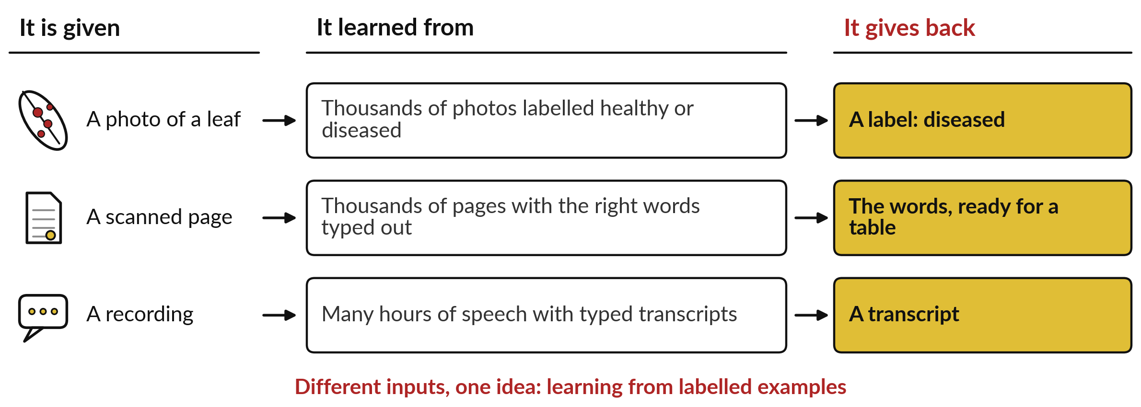
One idea, three inputs: learn from labelled
examples, then label something new
Photos, pages and speech differ only in what goes in. The learning is the same.
Notes:
Here are the three side by side, and this is the slide to remember. Given a photo of a leaf, a model that learned from thousands of photos labelled healthy or diseased gives back a label. Given a scanned page, a model that learned from pages with their words typed out gives back the words, ready for a table.
Given a recording, a model that learned from hours of speech with transcripts gives back a transcript. Reading documents and turning speech into text are therefore no new ideas. They are the same idea, learning from labelled examples, applied to a different input. Which tells you, too, where all three are strong and where they break.

Slide 15
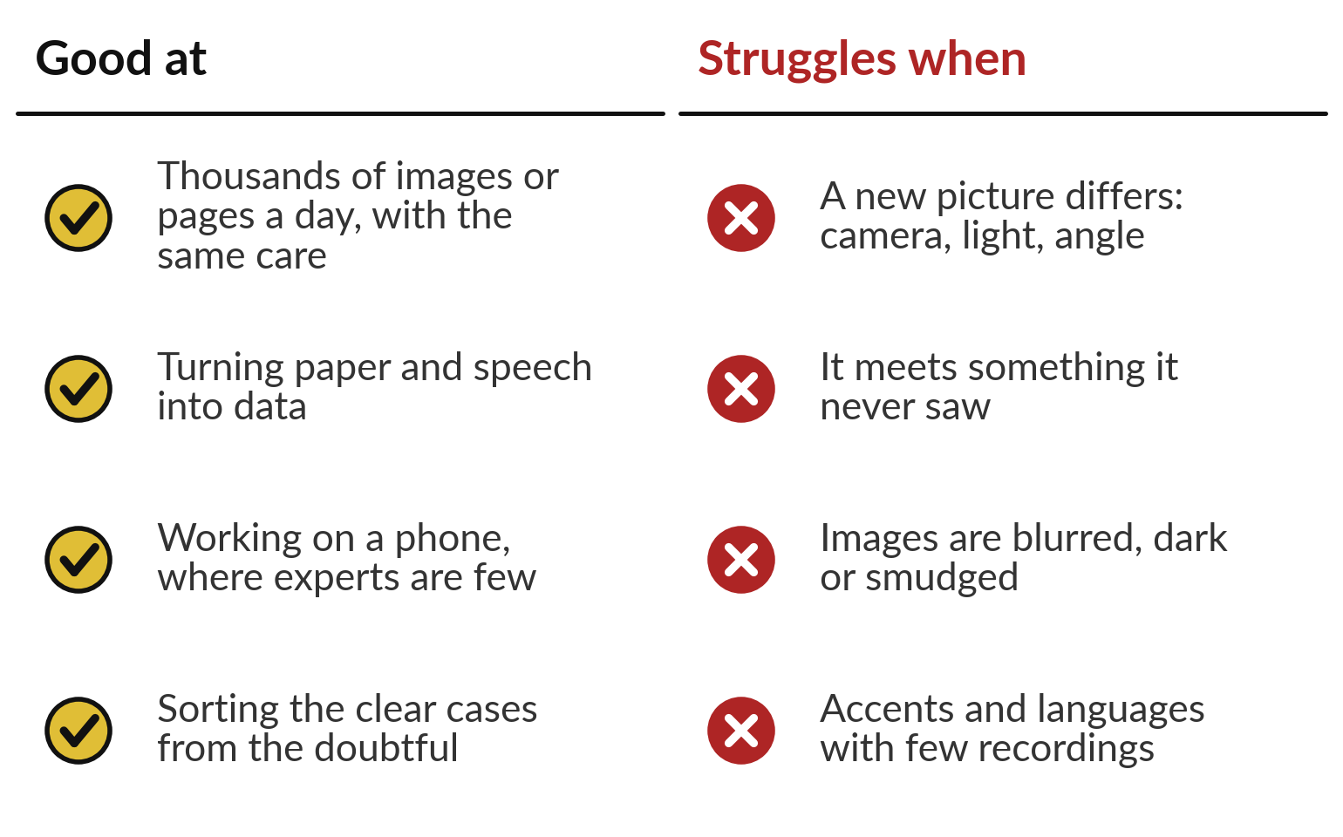
It is good at volume and consistency, and struggles
when a new picture differs from its examples
It knows only the kind of pictures it learned from.
Strong: many images, the same care, on a phone.
Weak: new cameras, poor light, things it never saw.
Notes:
Because all three learn from examples, they share strengths and weaknesses. They are good at volume: thousands of images or pages a day, each read with the same care at five in the evening as at nine in the morning. They turn paper and speech into data a system can use, they run on a phone where experts are few, and they sort the clear cases from the doubtful.
They struggle when the new picture differs from the examples: another camera, poor light, a different angle, a blurred or smudged image, an accent they rarely heard, or something they never saw at all. That last list is the one to keep. Here is what it looked like in real clinics.

Slide 16
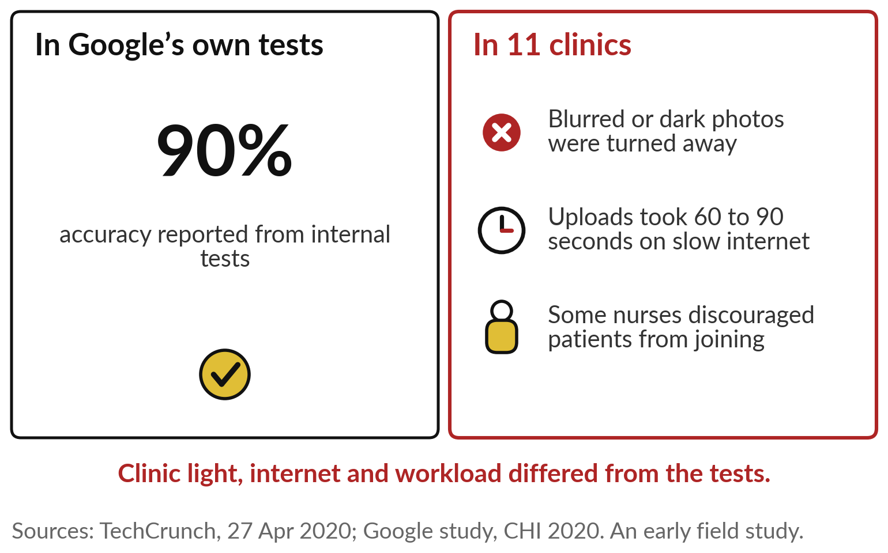
Google’s eye screening scored 90% in its own tests;
in clinics, dark and blurred photos were turned away
The tests and the clinic were different worlds.
Thai nurses photographed diabetic patients’ eyes.
Light, internet and nurses’ workload differed from the tests.
Test it where it will be used.
Notes:
Google Health worked with Thailand’s Ministry of Public Health on screening diabetic patients for eye disease. A nurse photographs the back of the eye, and the system grades it in about a minute. In Google’s internal tests it showed 90 per cent accuracy. Then, in eleven real clinics, it rejected photos that were blurred or dark, and only some clinics had a room they could darken.
Slow internet made some uploads take 60 to 90 seconds, and some nurses discouraged patients from joining because of the extra burden. This was an early field study, published by Google itself, and it does not mean the product later failed. The lesson is the gap between the test and the clinic: test it where it will be used.
So what should a good system do when unsure?

Slide 17
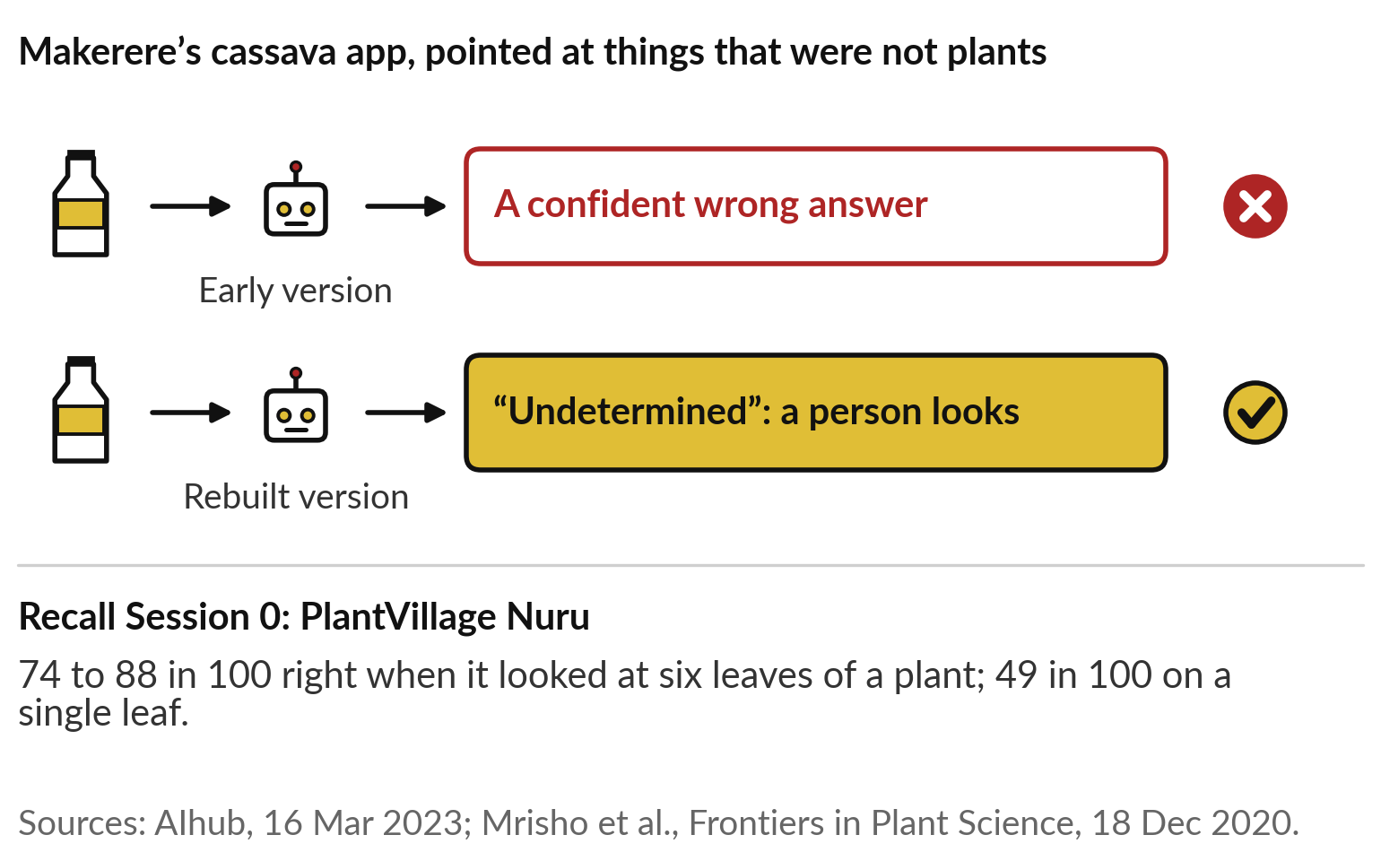
A good system says “not sure”
and passes the case to a person
Ask every vendor what the tool does with a picture it cannot read.
Makerere rebuilt its app to answer “undetermined”.
Session 0: Nuru was far better on six leaves than on one.
Notes:
It should admit it. Makerere’s team found that an early version of the cassava app gave answers even when pointed at things that were not plants at all. A model trained only on cassava photos will force every picture into one of the labels it knows. So the team rebuilt it to answer undetermined, and hand the case to a person.
You met the other half of this in Session 0: PlantVillage Nuru was right 74 to 88 times in 100 when it looked at six leaves of a plant, and 49 in 100 on a single leaf. How the tool is used changes the score. Ask every vendor what theirs does with a picture it cannot read.
Now, where is this at work?

Slide 18
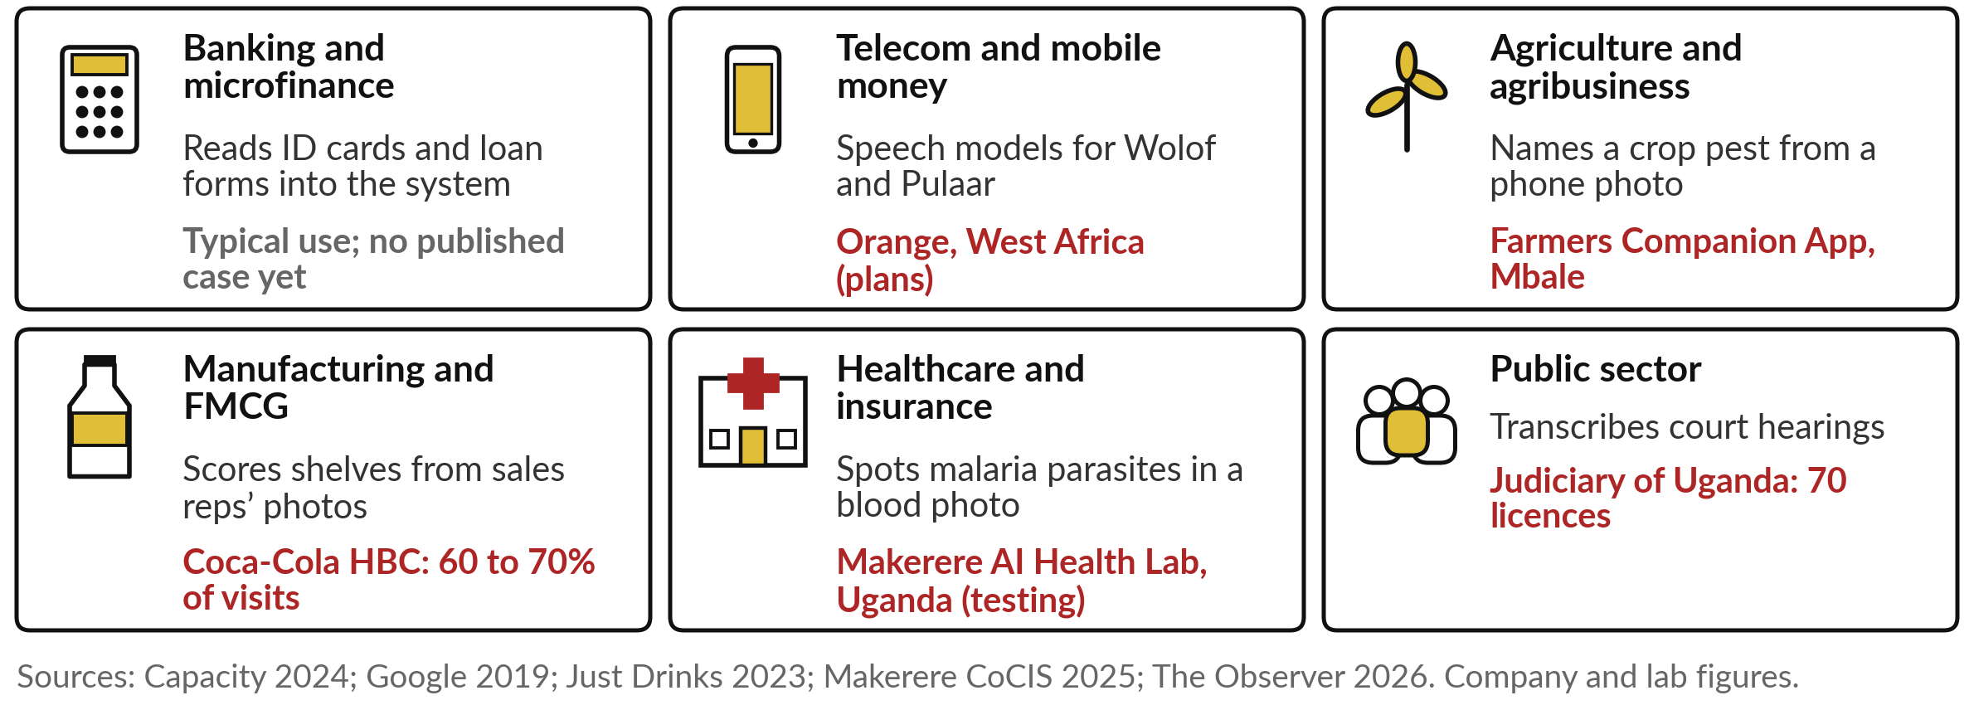
Seeing and reading at work in six industries,
with one named example where we have one
Three of them follow as stories: forms read in Burundi, scans in Sweden, hearings in Kenya.
Notes:
Here is today’s idea across the six main industries. In banking, the typical use is reading ID cards and loan forms into the system; we found no published case with a named bank yet, so the tile says so rather than invent one. In telecom, Orange plans speech models for customers in Wolof and Pulaar, in West Africa.
In agriculture, a developer in Mbale built a free app that spots fall armyworm on maize from a photo. In FMCG, Coca-Cola HBC’s sales reps photograph shelves, and image recognition scores the display on 60 to 70 per cent of visits, by the company’s own account. In health, Makerere’s AI Health Lab points out malaria parasites in a blood-smear photo, a tool still in testing.
And Uganda’s Judiciary bought 70 licences for court transcription. Three stories follow.

Slide 19
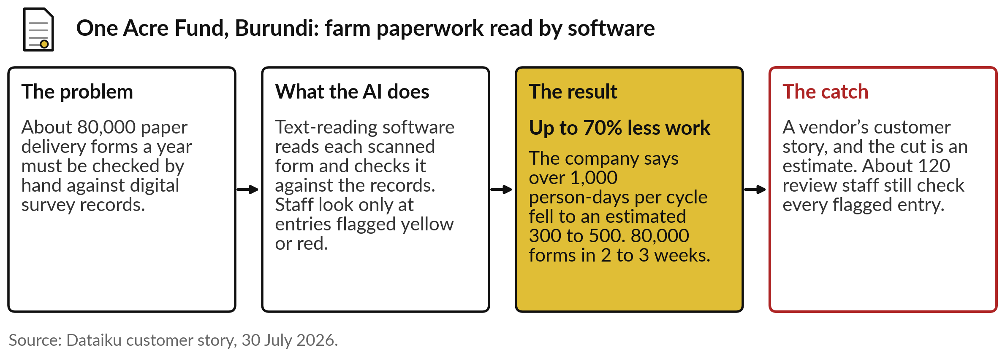
One Acre Fund, Burundi: software reads 80,000
paper forms a year, and staff check what it flags
Reading paper: the software reads, people decide on what it flags.
Notes:
The first story reads paper. One Acre Fund supplies seed and fertiliser to smallholder farmers, and in Burundi it receives about 80,000 paper delivery forms a year, each to be checked against digital survey records. Text-reading software, the OCR from our earlier picture, now reads each scanned form and compares it with the records.
Staff look only at the entries the system flags in yellow or red. The company says the work fell from more than 1,000 person-days per cycle to an estimated 300 to 500, a cut of up to 70 per cent, and 80,000 forms went through in two to three weeks.
The catch: this is a vendor’s customer story and the figure is an estimate. About 120 review staff still check what it flags.

Slide 20
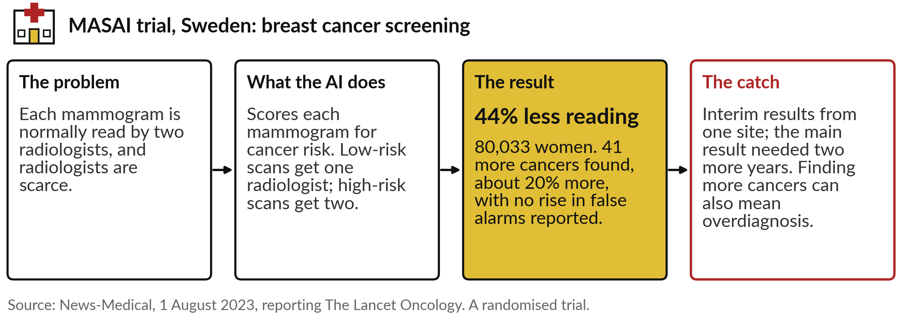
MASAI trial, Sweden: AI sorted mammograms, so
radiologists read 44% less and found more cancers
Seeing: the AI decides who reads each scan, and doctors still read every one.
Notes:
The second story sees, and it is the strongest evidence in today’s set because it was a randomised trial. In Sweden’s breast screening programme, each mammogram is normally read by two radiologists. In the MASAI trial, AI scored each scan for cancer risk. Low-risk scans got one radiologist, high-risk scans two.
Across 80,033 women, the AI group found 41 more cancers, about 20 per cent more, with no rise in false alarms reported, and radiologists did 44 per cent less reading. The catch: these were interim results from one site, the main result needed two more years of follow-up, and the authors warn that finding more cancers can also mean treating some that would never have caused harm. Notice that every scan still had a doctor.

Slide 21
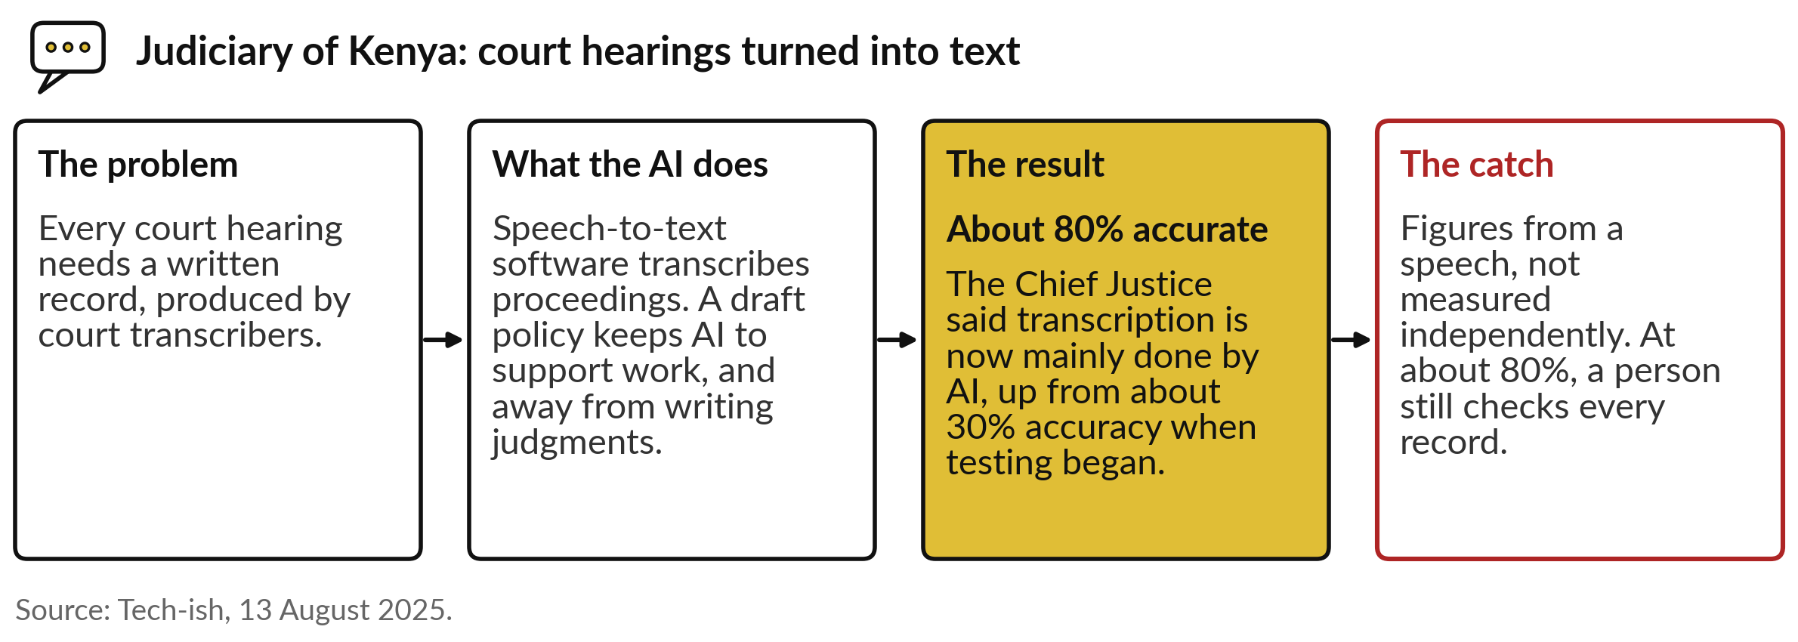
Judiciary of Kenya: AI now types most court
records, at about 80% accuracy by its own account
Hearing: Uganda’s Judiciary has bought 70 licences for the same kind of tool.
Notes:
The third story hears. Every court hearing needs a written record, and in Kenya that work is moving to speech-to-text software. In August 2025 Chief Justice Martha Koome said transcription is now mainly done by AI, and put its accuracy at about 80 per cent, up from about 30 per cent when testing began.
The Judiciary’s draft policy keeps AI to support work such as transcription and research, and away from writing judgments. The catch: those figures come from a speech and were not measured independently, and at 80 per cent a person must still check every record. Closer to home, Uganda’s Judiciary has bought 70 licences for AI transcription, so this is arriving here too. Now let me show you one learning, step by step.

Slide 22
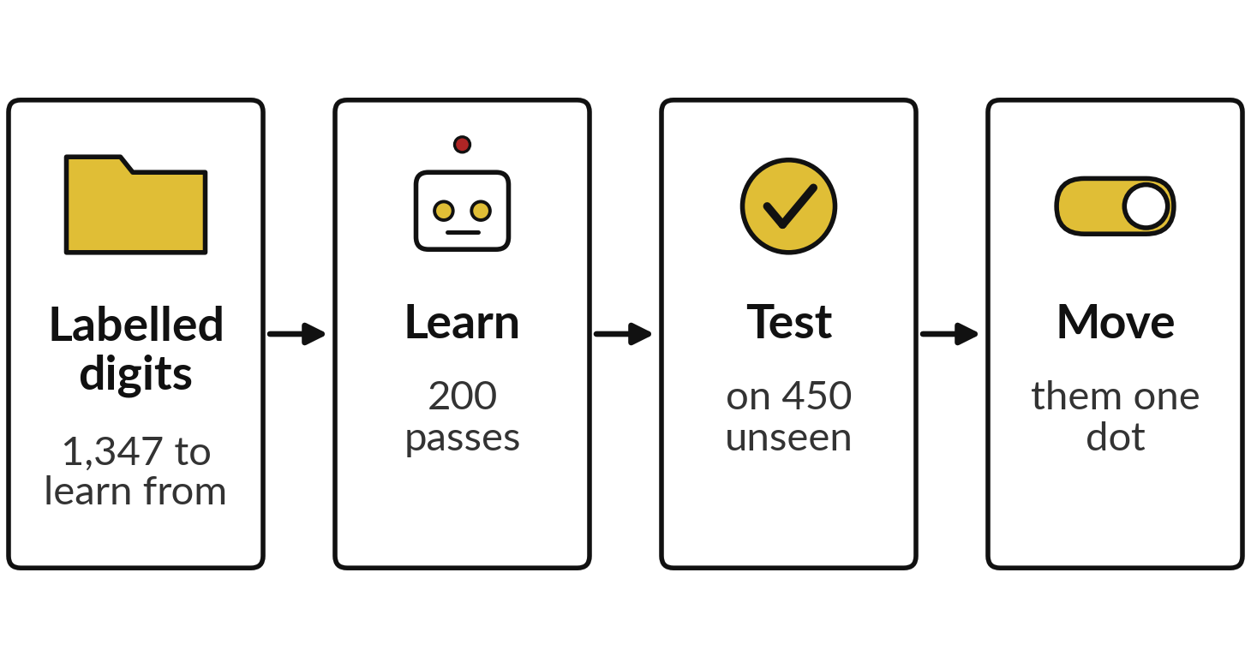
Demonstration: a small network learns
to read handwritten digits, recorded
I will show
Watch for
How it improves with practice
Which digits it gets wrong
What happens when the same digits move one dot
Notes:
Now you see the idea at work, on a task anyone can judge: reading handwritten digits. The pictures are 1,797 small scans of handwritten digits, each labelled with the right answer, from a public research collection. A small neural network learns from 1,347 of them and is tested on 450 it never saw.
I recorded the run on 5 November 2026 with a free tool called scikit-learn; it gives the same result every time, and I ran it twice to check. Watch for three things: how it improves with practice, which digits it gets wrong, and what happens when I move the same digits one dot to the right. That last part answers our question about trust.

Slide 23
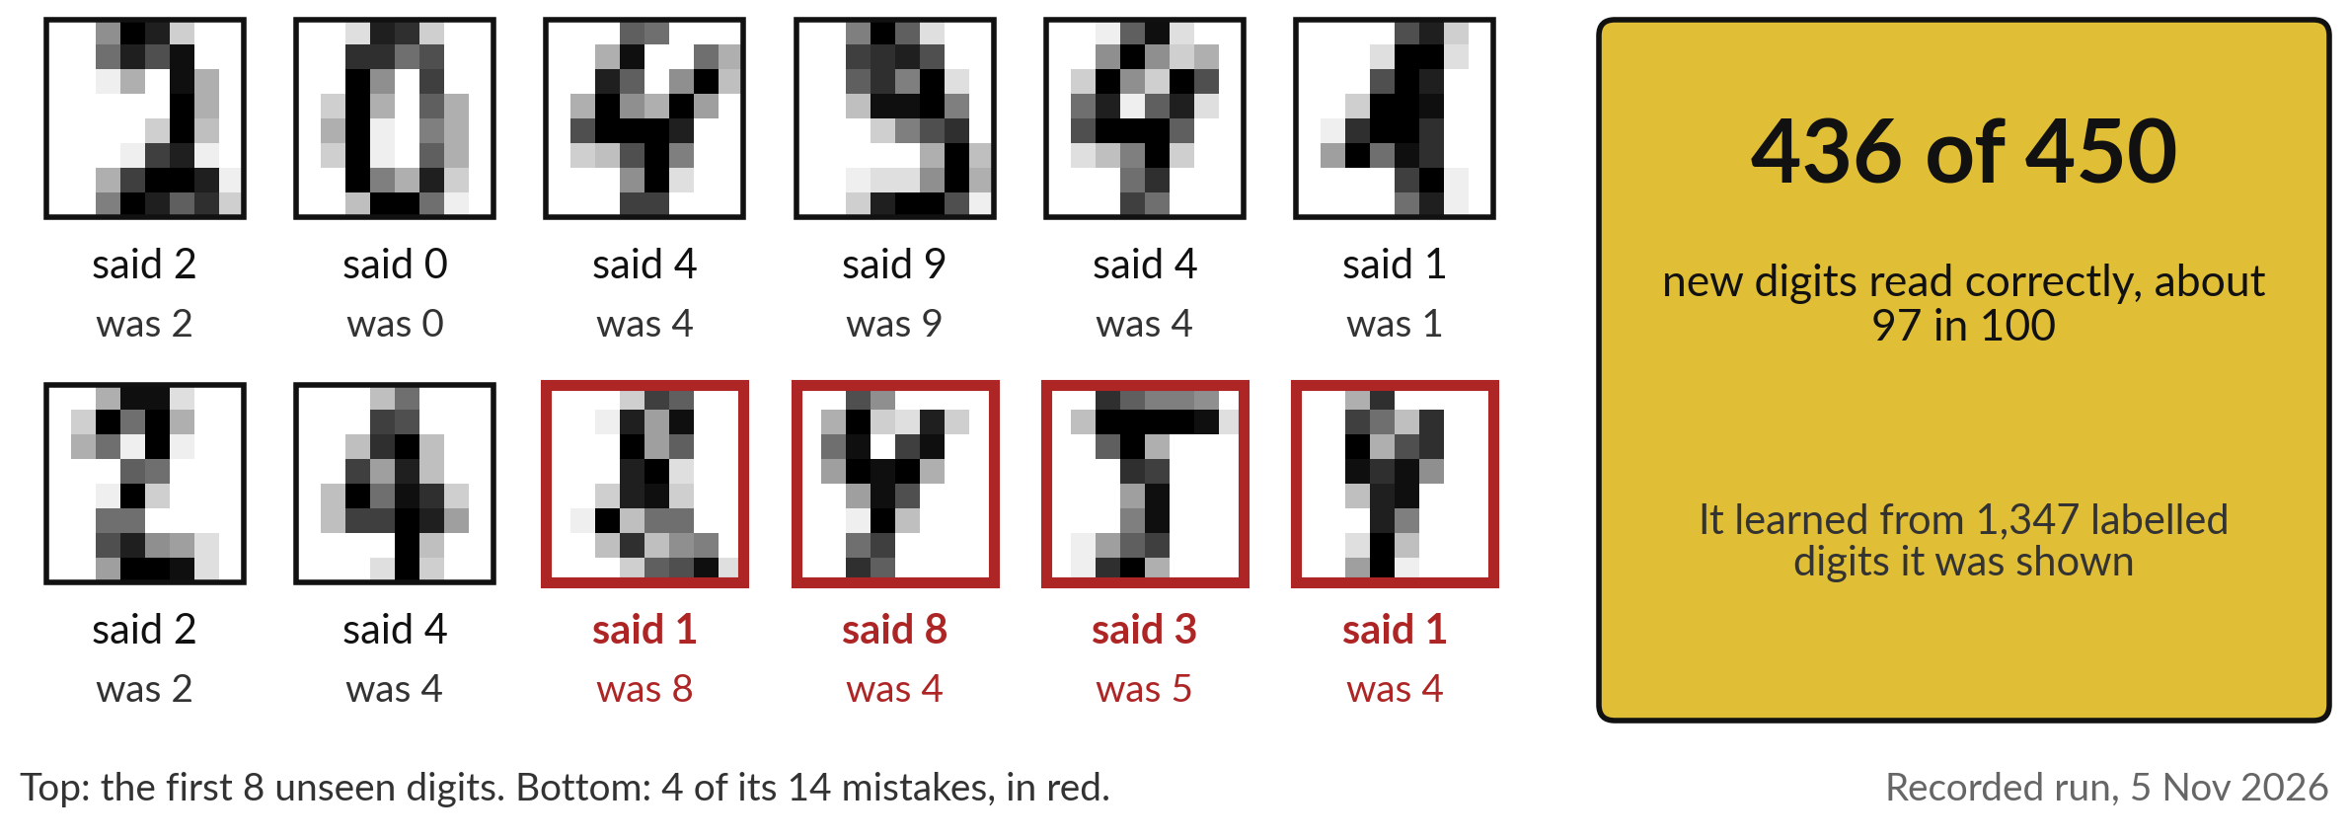
It learned from 1,347 labelled digits and
read 436 of 450 new ones correctly
Real pictures and answers from the recorded run; its mistakes are untidy digits.
Notes:
Here is the result on the 450 digits it never saw. It read 436 correctly, about 97 in 100, and got 14 wrong. The top row shows the first eight unseen digits with what the network said and what each really was; all eight are right. The bottom row ends with four of its fourteen mistakes, in red: an 8 read as a 1, a 4 read as an 8, a 5 read as a 3, a 4 read as a 1.
Look at them and you can see why: these are untidy digits a tired clerk might misread too. Notice also that nobody told it what a 4 looks like. It learned that from the labelled examples alone, through practice. So how much practice did it need?

Slide 24
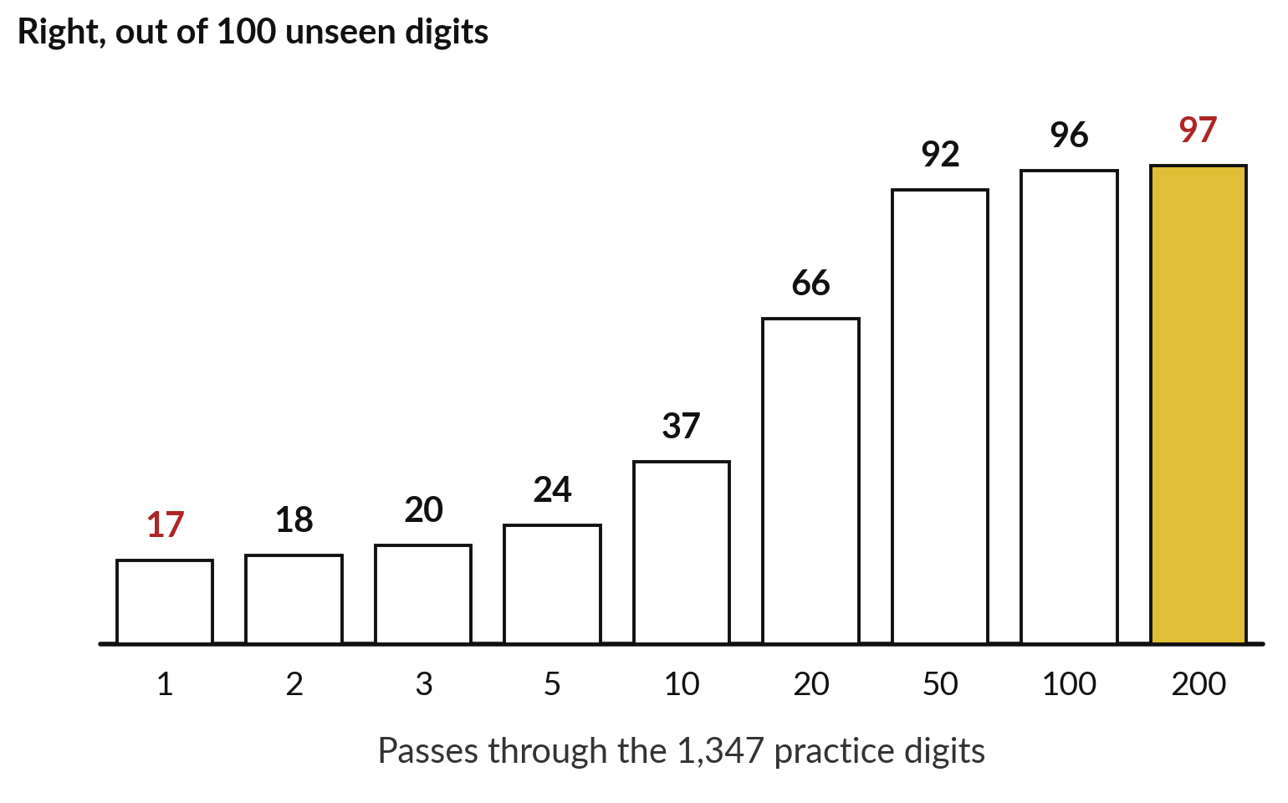
With practice it improved from
17 in 100 right to 97 in 100
Each pass, it adjusts itself a little to match the labels.
After one pass: 17 in 100 right.
After 50 passes: 92. After 200: 97.
Recorded run, 5 November 2026.
Notes:
It needed a lot. Each bar shows how many of 100 unseen digits it read correctly after a given number of passes through its 1,347 practice digits. After one pass it got 17 in 100 right, not much better than guessing among ten digits. After ten passes, 37.
After fifty, 92. After two hundred, 97. Each pass, the network adjusts itself a little so its answers match the labels better; that adjusting is what the industry calls training. For a leader the point is this: the quality comes from the examples and the practice, so a vendor who cannot tell you what their system learned from cannot tell you what it will do. And now the test that matters most.

Slide 25
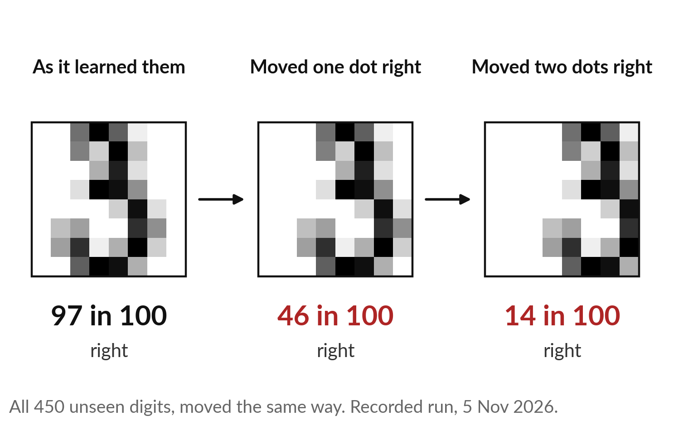
Move the same digits one dot to the right,
and it reads fewer than half correctly
A person would not notice. The network falls from 97 in 100 to 46.
It learned digits in one position.
A small change it never saw breaks it.
Test with your own photos, as they really come.
Notes:
Here it is. I took the same 450 unseen digits and moved each one dot to the right. You can barely see the difference, and a person would read every one exactly as before. The network fell from 97 in 100 right to 46. Moved two dots, it got 14 in 100.
Why?
Every digit it learned from sat in roughly the same place, so a shift it never saw is a new kind of picture to it. This is the same lesson as the Thai clinics and Nuru’s single leaf: a picture model struggles when the new picture differs from its examples.
Larger systems are trained on more varied photos and cope better, but the question stays: were they trained on pictures like yours?

Slide 26
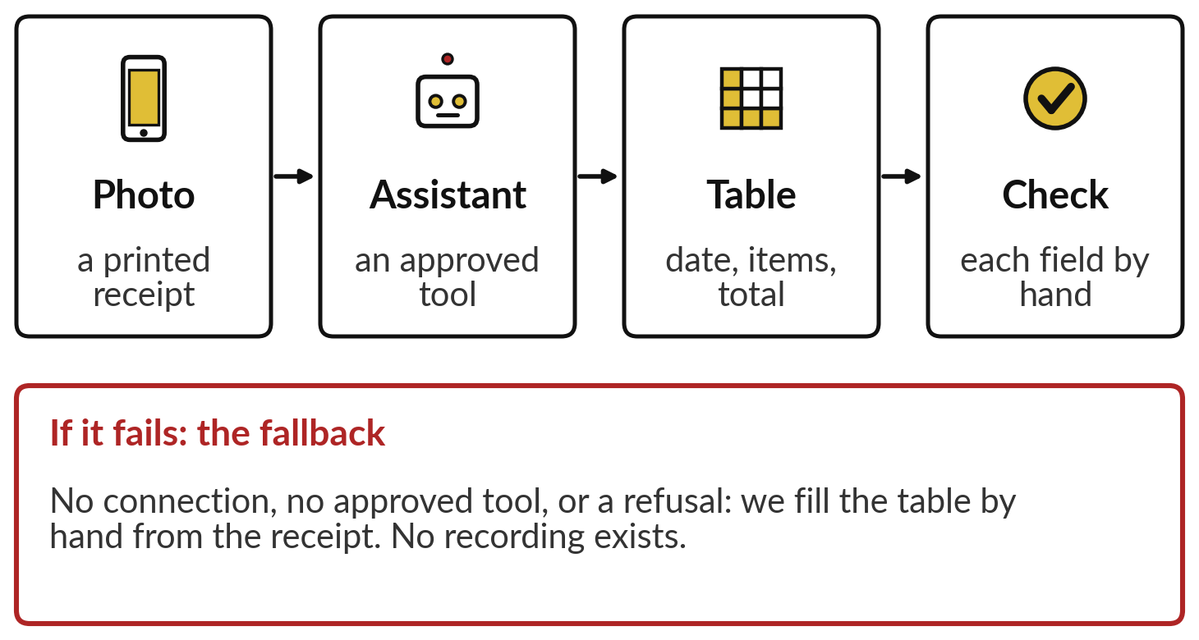
Live, with a fallback: an approved
assistant reads a receipt photo into a table
I will show
Watch for
Which fields come out right
What it does with a smudge or a crease
Whether it says when it is unsure
Notes:
Now a live try, and I say live because I have not recorded it, so neither of us knows the result. I photograph a printed receipt, one with no personal details, and ask an AI assistant your organisation has approved to put the date, the items and the total into a table.
Watch which fields come out right, what it does with a smudge or a crease, and whether it says when it is unsure. Then we check every field against the paper. If the connection or the tool fails, or it refuses, the fallback is on the slide: we read the receipt into the table by hand together, and compare the steps with what One Acre Fund’s software does at scale.
There is no recording, so I never describe a result we did not see. Either way, the habit we practise is checking the output against the source.

Slide 27
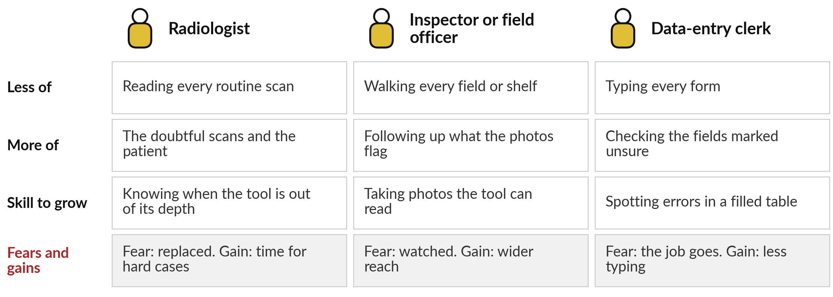
Your people: radiologists, inspectors and
clerks read less routine work and check more
One Acre Fund’s 120 reviewers and Sweden’s radiologists still check what the tool flags.
Notes:
We turn to your people, because these tools change jobs before they change results. Three roles feel it first. A radiologist reads fewer routine scans and spends more time on the doubtful ones and on the patient; the skill to grow is knowing when the tool is out of its depth.
An inspector or field officer walks fewer fields and shelves and follows up what the photos flag; the skill is taking photos the tool can read. A data-entry clerk types fewer forms and checks the fields marked unsure. The fears are real: being replaced, being watched, the job going.
The gains are time for hard cases and less typing. What do your clerks or inspectors fear about this today?

Slide 28
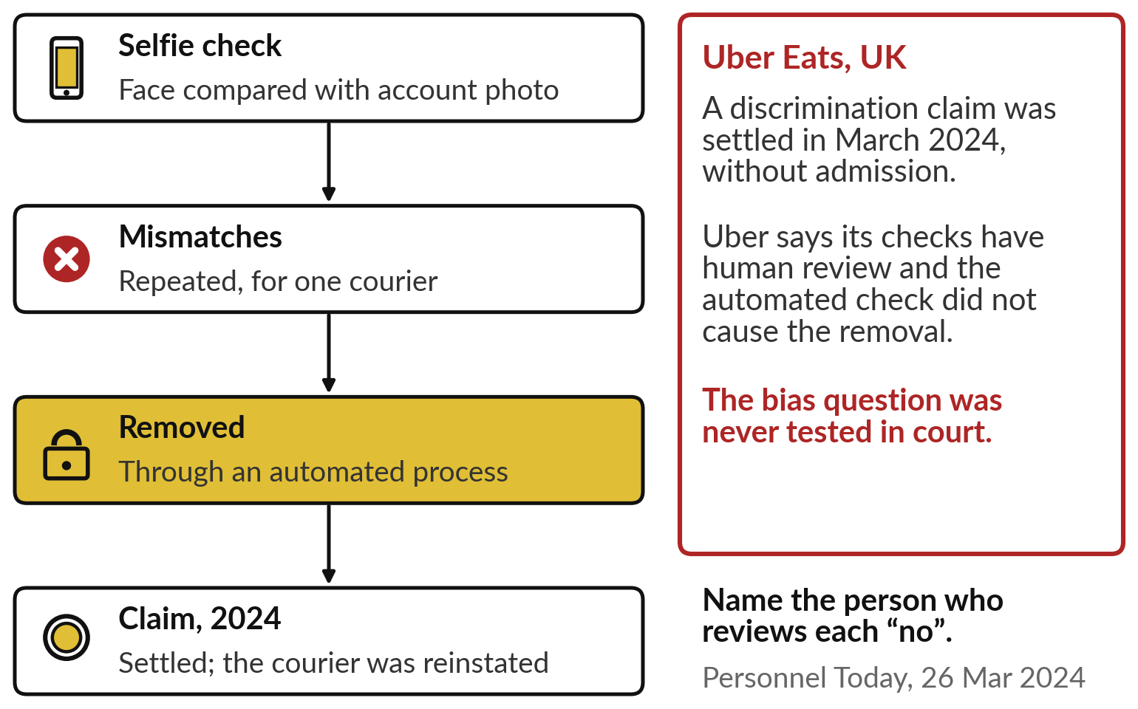
When a picture check says no to a person, someone
must review it and the person must be able to appeal
A face check is a picture model with a person’s livelihood behind it.
Name who reviews each “no”.
Give an appeal route.
Check it works for every group of staff.
Notes:
Whatever your people fear, the hardest case is when the picture is of a person. Uber Eats in the United Kingdom asks couriers for a selfie, which software compares with their account photo. After repeated mismatches, one Black courier was removed through an automated process. With support from the Equality and Human Rights Commission and a union, the courier brought a discrimination claim, which was settled in March 2024, and the courier was reinstated.
Uber says its checks have human review and that the automated check did not cause the removal, and the bias question was never tested in court. For you the rule is simple: name the person who reviews every no, and give people a way to appeal. Now, what should you ask before you buy?

Slide 29

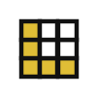




Questions to ask your team and your
vendor before AI sees or reads for you
Ask | Why it matters
What pictures, pages or recordings did it learn from? | It only knows the kind it was shown
Were they like ours: our cameras, forms, languages, light? | A new kind of picture breaks it
How often is it right on our own samples? | The vendor’s score was on their pictures
What does it do with a picture it cannot read? | A good tool says “not sure”
Who checks what it flags, and who reviews a “no” about a person? | People answer for the decision
Where do our images and recordings go? | Photos and voices can be personal data
Notes:
Everything so far comes down to six questions, one per row. Ask what pictures, pages or recordings it learned from, because it only knows the kind it was shown. Ask whether they were like yours: your cameras, your forms, your languages, your light. Ask how often it is right on a sample of your own, since the vendor’s score was measured on their pictures; Session 3 shows how to read that score.
Ask what it does with a picture it cannot read. Ask who checks what it flags, and who reviews a no about a person. And ask where your images and recordings go, because faces and voices can be personal data; check that point with your lawyer. Now we turn them on your own organisation.

Slide 30
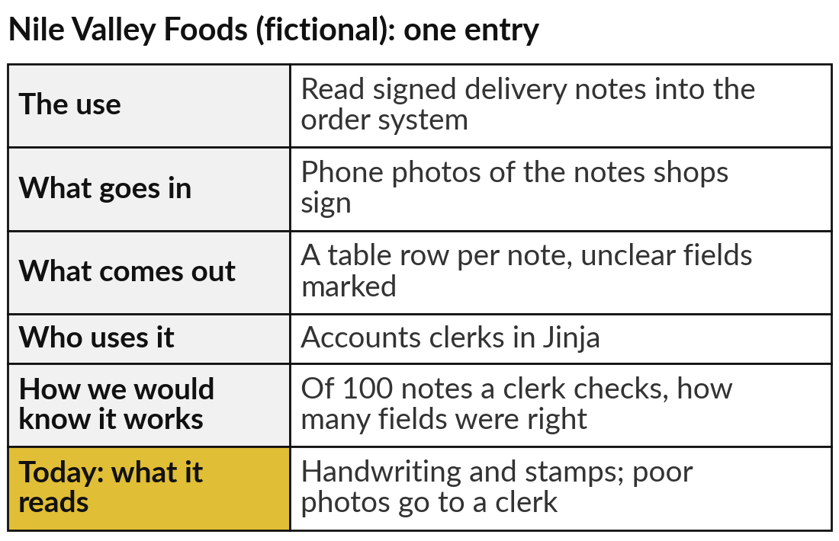
Add one place where AI could see or read
for you to your AI Opportunity Portfolio
25 minutes
Hands-on: your portfolio
Find a pile of photos, paper or recordings that people in your organisation look at by hand.
Name the pile and who handles it today.
Fill the five columns, as in the example.
Add today’s column: what it sees or reads, and what happens to poor pictures.
Write one question for the vendor.
You keep: One or two portfolio entries, each with its poor-picture rule.
Notes:
For twenty-five minutes you work on your own organisation, and I walk round. Open the AI Opportunity Portfolio in your workbook. Look for a pile that people handle by eye or by hand today: delivery notes, invoices, ID copies, meter photos, shelf photos, X-rays, call recordings or meeting minutes.
Name the pile and who handles it. Fill the five columns: the use, what goes in, what comes out, who uses it, and how you would know it works. Then today’s column: what exactly it sees or reads, and what happens to a poor picture. The example on the right is for Nile Valley Foods, our fictional distributor. Finish with one question you would put to a vendor.

Slide 31
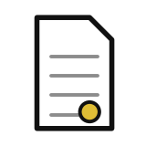



Which pile of pictures, paper or speech in
your organisation would you start with?
Of the uses you just wrote, which would you start with, and why?
Paper to data
Photos to check
Speech to text
Not yet
Forms, invoices or delivery notes typed in by hand today
Shelves, crops, meters or damage that inspectors look at
Meetings, hearings or calls that someone writes up
Our pictures vary too much, or no one could check the results
Write your decision and the reason in your workbook.
Notes:
With your entries written, one decision. Of the uses in your portfolio, which would you start with?
Paper to data, if forms, invoices or delivery notes are typed in by hand today. Photos to check, if inspectors or reps spend their days looking at shelves, crops, meters or damage. Speech to text, if meetings, hearings or calls are written up by someone. Or not yet, if your pictures vary too much or no one could check the results; that is an honest answer, and your first step becomes collecting good examples.
Remember One Acre Fund: start where the volume is high and a person can check what is flagged. Tell me your choice and the pile it works on.

Slide 32
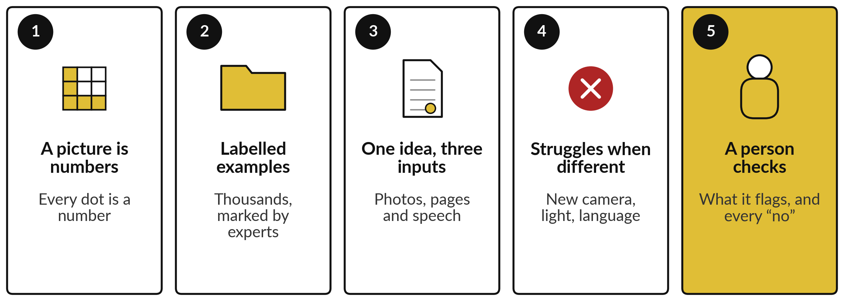
Take-away: five things to remember
Notes:
Here is the session in five lines. To a computer a picture is numbers, one for every dot. A model learns to see from thousands of examples that experts have labelled, the way an apprentice learns from a senior. Reading documents and turning speech into text are the same idea, applied to pages and to sound.
It struggles when a new picture differs from its examples, as our network did when the digits moved one dot and fell from 97 in 100 to 46. And a person checks what it flags, and reviews every no about a person. Now, what you take away.

Slide 33
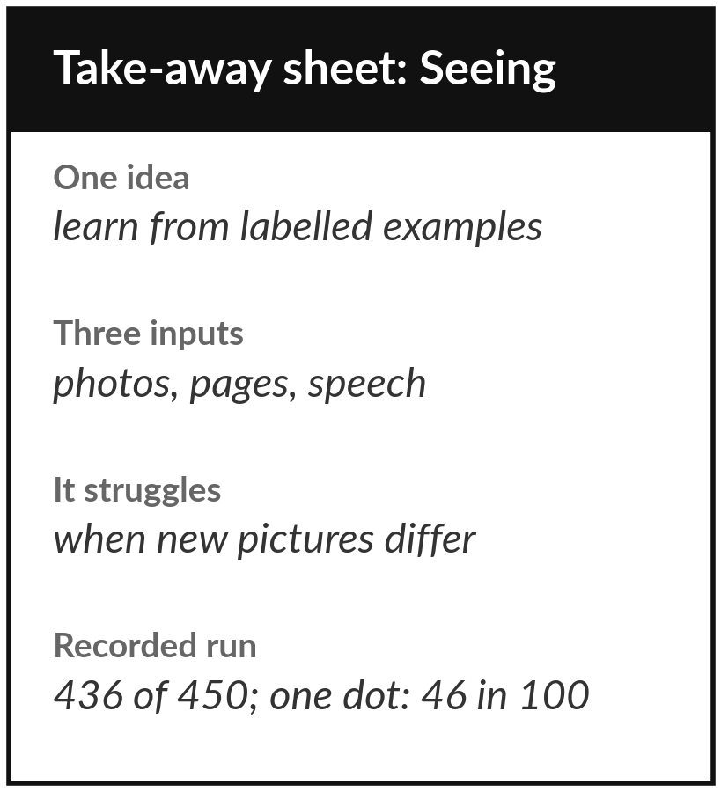
Keep the sheet, and the seeing or
reading use you added to your portfolio
What you keep from today
A one-page sheet: one idea behind seeing, reading and hearing, when it struggles, the questions to ask, today’s recorded results, and your new portfolio entry.
Our question today
What can AI see or read for us, and when should we not trust what it sees?
Next session
Session 2: AI that predicts from your data.
Notes:
Keep the take-away sheet. It holds the one idea behind seeing, reading and hearing, the ways it struggles, the questions for your team and your vendor, and today’s recorded numbers: 436 of 450 new digits read correctly, and only 46 in 100 once the same digits moved one dot.
Your portfolio now holds a place where AI could see or read for you. In Session 2 the same learning from labelled examples turns to the records you already keep: who will repay, order, leave or break down next.
We began with this question: What can AI see or read for us, and when should we not trust what it sees? Before you go, say in one sentence what you can now say about it.

